Slide 1
What You
Need to Know
About Financial Aid

Slide 2
Topics We Will Discuss Tonight
What is financial aid
Cost of attendance (COA)
Expected Family Contribution (EFC)
What is financial need
Categories, types, and sources of financial aid
Free Application for Federal Student Aid (FAFSA)
Special circumstances

Slide 3
What is Financial Aid?
Financial aid consists of funds provided to students and families to help pay for postsecondary educational expenses

Slide 4
What is Cost of Attendance (COA)
Direct costs
Indirect costs
Direct and indirect costs combined into cost of attendance
Varies widely from college to college

Slide 5
What is the Expected Family Contribution (EFC)
Amount family can reasonably be expected to contribute
Stays the same regardless of college
Two components
  Parent contribution
  Student contribution
Calculated using data from a federal application form and a federal formula

Slide 6
What is Financial Need
Cost of Attendance
– Expected Family Contribution
= Financial Need

Slide 7
Categories of Financial Aid
Need-based
Non-need-based

Slide 8
Types of Financial Aid
Scholarships
Grants
Loans
Employment
Gift Aid
Self-Help Options

Slide 9
Gift Aid: Scholarships
Money that does not have to be paid back
Awarded on the basis of merit, skill, or unique characteristic

Slide 10
Gift Aid: Grants
Money that does not have to be paid back
Usually awarded on the basis of financial need

Slide 11
Self-Help Option: Loans
Money students and parents borrow to help pay college expenses
Repayment usually begins after education is finished
Only borrow what is really needed
Look at loans as an investment in the future

Slide 12
Self-Help Option: Employment
Allows student to earn money to help pay educational costs
A paycheck; or
Non-monetary compensation, such as room and board

Slide 13
Sources of Financial Aid
Federal government
States
Private sources
Civic organizations and churches
Employers

Slide 14
Federal Government
Largest source of financial aid
Aid awarded primarily on the basis of financial need
Must apply each year using the Free Application for Federal Student Aid (FAFSA)

Slide 15
Common Federal Aid Programs
Federal Pell Grant
Teacher Education Assistance for College and Higher Education Grant
Federal Supplemental Educational Opportunity Grant
Federal Perkins Loan
Federal Work-Study
Subsidized and Unsubsidized Loans
PLUS Loans

Slide 16
States
Residency requirements
Award aid on the basis of both merit and need
Use information from the FAFSA
Deadlines vary by state; check paper FAFSA or FAFSA on the Web site

Slide 17
Private Sources
Foundations, businesses, charitable organizations
Deadlines and application procedures vary widely
Begin researching private aid sources early

Slide 18
Civic Organizations and Churches
Research what is available in community
To what organizations and churches do student and family belong?
Application process usually spring of senior year
Small scholarships add up!

Slide 19
Employers
Companies may have scholarships available to the children of employees
Companies may have educational benefits for their employees

Slide 20
Free Application for Federal Student Aid (FAFSA)
A standard form that collects demographic and financial information about the student and family
May be filed electronically or using paper form
  Available in English and Spanish

Slide 21
FAFSA
Information used to calculate the Expected Family Contribution or EFC
  The amount of money a student and his or her family may reasonably be expected to contribute towards the cost of the student’s education for an academic year
Colleges use EFC to award financial aid

Slide 22
FAFSA
May be filed at any time during an academic year, but no earlier than the January 1st prior to the academic year for which the student requests aid
For the 2013–14 academic year, the FAFSA may be filed beginning January 1, 2013
Colleges may set FAFSA filing deadlines

Slide 23

FAFSA on the Web
Website: www.fafsa.gov
2013–14 FAFSA on the Web available on
January 1, 2013
FAFSA on the Web Worksheet:
  Used as “pre-application” worksheet
  Questions follow order of FAFSA on the Web

Slide 24
FAFSA on the Web
Good reasons to file electronically:
Built-in edits to prevent costly errors
Skip logic allows student and/or parent to skip unnecessary questions
Option to use Internal Revenue Service (IRS) Data Retrieval Tool

Slide 25
FAFSA on the Web
Good reasons to file electronically:
More timely submission of original application and any necessary corrections
More detailed instructions and “help” for common questions
Ability to check application status online
Simplified application process in the future

Slide 26
IRS Data Retrieval Tool
While completing FOTW, applicant may submit real-time request to IRS for tax data
IRS will authenticate taxpayer’s identity
If match found, IRS sends real-time results to applicant in new window
Applicant chooses whether or not to transfer data to FOTW

Slide 27
IRS Data Retrieval Tool
Available early February 2013 for 2013–14 processing cycle
Participation is voluntary
Reduces documents requested by financial aid office

Slide 28
IRS Data Retrieval Tool
Some will be unable to use IRS DRT
Examples include:
  Filed an amended tax return
  No SSN was entered
  Student or parent married but filed separately

Slide 29
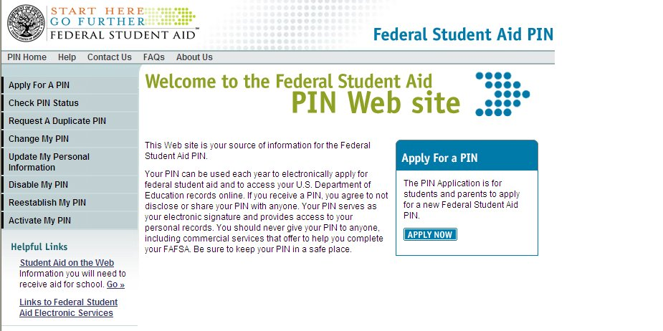
Federal Student Aid Personal Identification Number (FSA PIN)
Website: www.pin.ed.gov
Sign FAFSA electronically
Not required, but speeds processing
May be used by students and parents throughout aid process, including subsequent school years

Slide 30
FAFSA on the Web Worksheet
2013–14 FAFSA on the Web Worksheet contains:
Instructions
Questions that gather basic information on student and parent, if applicable

Slide 31
General Student Information
Social Security Number
Citizenship status
Drug convictions
Selective Service registration
High School Completion

Slide 32
Student Dependency Status
FAFSA asks questions to determine status:
If all “No” responses, student is dependent
If “Yes” to any question, student is independent

Slide 33
Information About the Parents of Dependent Students
Tax, income, and other financial information
Dislocated worker status
Assets

Slide 34
Information About the Student
(and Spouse)
Tax, income, and other financial information
Dislocated worker status
Assets

Slide 35
Additional Information
College and housing information

Slide 36
Signatures
Required
  Student
  One parent (dependent students)
Format
  Electronic using PIN
  Signature page
  Paper FAFSA

Slide 37
Frequent FAFSA Errors
Social Security Numbers
Divorced/remarried parental information
Income earned by parents/stepparents
Untaxed income
U.S. income taxes paid
Household size
Number of household members in college
Real estate and investment net worth

Slide 38
FAFSA Processing Results
Central Processing System (CPS) notifies student of FAFSA processing results by:
Paper Student Aid Report (SAR) if paper FAFSA was filed and student’s e-mail address was not provided
SAR Acknowledgement if filed FAFSA on the Web and student’s e-mail address was not provided

Slide 39
FAFSA Processing Results
CPS notifies student of FAFSA processing results by:
  E-mail notification containing a direct link to student’s on-line SAR if student’s e-mail was provided on paper or electronic FAFSA
Student with PIN may view SAR on-line at www.fafsa.gov

Slide 40
FAFSA Processing Results
Institutional Student Information Record (ISIR) sent to colleges listed on FAFSA approximately 10 to 14 days after FAFSA submitted
College reviews ISIR
  May request additional documentation, such as proof that a sibling is enrolled in college

Slide 41
Student Aid Report
Review data for accuracy
Update estimated information when actual figures are available

Slide 42
Making Corrections
If necessary, corrections to FAFSA data may be made by:
Using FAFSA on the Web (www.fafsa.gov) if
student has a PIN;
Updating paper SAR (SAR Information Acknowledgement cannot be used to make corrections); or
Submitting documentation to college’s financial aid office

Slide 43
Special Circumstances
Cannot report on FAFSA
Send written explanation to financial aid office at each college

Slide 44
Special Circumstances
Change in employment status
Medical expenses not covered by insurance
Change in parent marital status
Unusual dependent care expenses
Student cannot obtain parent information

